Slide 1
Welsh Youth Parliament
Name

Slide 2
It starts with you!
THE WELSH YOUTH PARLIAMENT PUTS POWER INTO THE HANDS OF YOUNG PEOPLE LIKE YOU.
It focuses on issues that are important to you, working with the Senedd to make your voice heard by those with the power to make change.

Slide 3
My three key issues
Issue 1
Issue 2
Issue 3

Slide 4
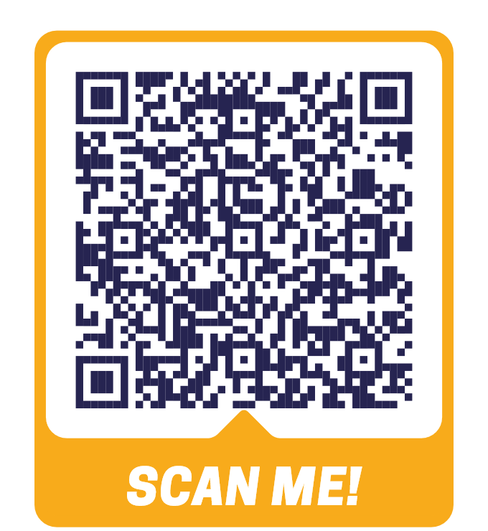
REGISTER TO VOTE!
YOUR VOICE IS POWERFUL!
The Welsh Youth Parliament has been turning up the volume on young voices across Wales, tackling the issues that truly matter to you!
Now you get to decide who represents you in the Welsh Youth Parliament.
Visit: YOUTHPARLIAMENT.WALES/ REGISTER-TO-VOTE

